Slide 1
Abstract Data Type and Data Structures
Unit 3
CPRG304 – Object-Oriented Programming III
Notes:
Recall performance/efficiency is not just the algorithm, but also what you’re using to store the data you’re accessing and manipulating – this is referred to as the data structure and so far we have used just basic arrays to sort our data.
“Data structures and algorithm” you always hear about these 2 things together and that’s because they are tightly-coupled – one affects the other and vice versa!
So what is a data structure? “official” definition – implementation of an ADT, which is abstract, not quite real… the DS makes an ADT real! Well then, what is an ADT? Let’s break it down word by word…

Slide 2
The Four Pillars of OOP
OOP is all about data modelling
  Identify objects of the system and how they relate to each other
Inheritance – “is a”
Polymorphism – “one name, many forms”
  Subtype or parametric
Encapsulation – “time capsule”
  Orthogonality (separation of concerns/single responsibility)
Abstraction – “need-to-know basis”
Notes:
Relationships can be “has a” (composition, contains/owns an instance), “uses a” (aggregation, references/doesn’t own) or “is a” (inheritance, class not objects)

Slide 3
Abstraction
Suppressing details to emphasize on what is relevant at the moment
  Represent data at a conceptual level without any details
Provides high level views of objects and their behaviours
  Enables us to forget about the low-level details and concentrate on the problem at hand
  Level of abstraction will depend upon the view point of the user and the problem to be solved
Notes:
We’ll come back to this! “abstraction” alone doesn’t make much sense without context.

Slide 4
Data
Definition: independent facts, observations, or events.
Example: Data about a student
  Name
  ID
  Program
  Year
  GPA
Notes:
Qualitative or quantitative values – “raw data”

Slide 5

Data vs. Information
Low <------- level of abstraction -----→ High
Data → (apply meaning) → Information
E.g. Data: red octagon, white border with letters S, T, O, P.
Information: A stop sign.

Slide 6
Data Type vs. Data Structures
Data Type: classification of data, logical description that determines possible values of the type and the operations that can be done on it
  E.g. integers – whole numbers, no decimal points
Data Structure: implementation of data types, concrete actual representation of data, a particular way of storing and organizing data
  E.g. Java INT – exactly 4 bytes to represent value from -2,147,483,648 to +2,147,483,647 (=2³¹, 1 bit for sign)
Notes:
What we call data types are actually data structures! But in our SD world, we call common or well-known data structures (like primitives and String) a data type, and complex data types are referred to as data structures…

Slide 7
Abstract Data Types (ADT)
A (mathematically) specified model of data-storing entities with operations on that data
  An ADT specifies what each operation does, but not how it does it!
    A data type that does not specify an implementation
    Logical description of the data and operations/rules to access or manipulate the data
  An ADT is realized/implemented by a concrete data structure
    E.g. integers, can add, subtract, compare, etc.
    E.g. text, can append, concat, get size, etc.

Slide 8
Abstract Data Types (ADTs)
Implementation independent!
  E.g. SHORT or INT for integers
  E.g. String class for text, can be done with arrays or linked lists
  Can be implemented in any language
ADTs defines the WHAT, not the HOW
  Abstraction separates the purpose from implementation
  Provides encapsulation, orthogonality and flexibility to maximize effectiveness and efficiency
Notes:
Short = int16 in C#
Int = int32 in C#

Slide 9
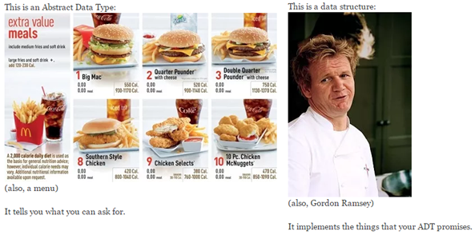
ADT vs. Data Structure
ADT is the CONTRACT – what the ADT promises to others, what the ADT is and how you can interact with it!
Notes:
Img src=“https://www.quora.com/Whats-the-difference-between-a-data-structure-and-an-abstract-data-type”

Slide 10
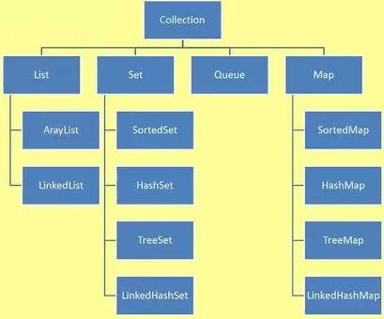
Java ADTs
Usually done as an Interface, mostly to represent large sets of data (collections)
A class can extend multiple interfaces = only way to achieve multiple inheritance in Java
Notes:
Img src = “https://examples.javacodegeeks.com/adt-java-tutorial/”

Slide 11
Implementing an ADT
An ADT specification only tells you WHAT you can expect
  You can use an ADT without knowledge of its implementation
It’s our responsibility as the programmer to follow these specifications
  This is our contract!
Unit tests provided to test your code in this course
  This will ensure our implementation satisfies the ADT
Notes:
Just like how we use the Java API! You just read about the method signature – the parameters and return values, but unless you go look at the source code – you don’t know and you don’t care how it’s actually implemented!

Slide 12
CounterADT Exercise
You will be implementing a class called Counter. An object of this class will be used to count things, so it will record a count that is a non-negative whole number. This class can set the counter to a given integer, increase the counter by 1, and decrease the counter by 1. It can also return the current count as an integer and a string to be displayed on the screen. It has the ability to determine if the counter is zero at any given point in time.

Slide 13
Understanding the Problem
Counter
- counter: int
+ setCounter( num: int ) : void + incCounter() : void + decCounter() : void + getCounter() : int + toString() : String + isZero() : Boolean
What can go wrong? Non-negative value!
  Throws InvalidCounterException when object is mutated

Slide 14
Analysis the Interface
CounterADT.java
Reading the documentation is CRITICAL!
  Just as you would read the Java API to understand how to use a class and its methods, we need to interpret what is expected from the ADT!
Class header description: the purpose of the class
Method signature specification: how each method will operate
Notes:
Like using an API, you read the documentation on how to use it – what it expects as arguments and what you can expect to get from it and what it PROMISES to do!

Slide 15
ADT Specifications in Java
The Javadoc tells us how to implement the ADT operations:
  What inputs are needed
  What outputs are generated
  What can go wrong?
Parameters
Method
Return
Exceptions
Notes:
This gives us a method signature!

Slide 16
Common Operations (Method Types)
Constructors – creates the ADT and initializes state
Accessors (Getters) – returns a value from the collections or the whole collection, or some information about the ADT
  next(), min(), size()
Mutators (Setters) – modifies the collection in any way
  add(), replace(), clear()
Transformers – similar to getters but changes the data value or type being returned
  isEmpty(), toString(), hashCode()

Slide 17
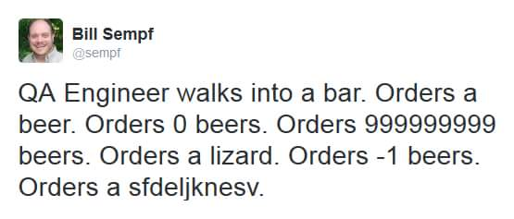
Review the Unit Tests
Notes:
Check out CounterTest.java!

Slide 18
The Implementation
A few specific steps to follow first:
  Create Counter class that implements the CounterADT interface
    Add all inherited methods
  All tests should fail right now!
    It’s ok! Nothing is “wrong” – this is normal!
Pick one method and one corresponding test, write the code to pass the test!
  Don’t try to add anything extra or fancy yet!
  Keep it simple! You can always refactor later!
Notes:
Repeat for other tests of the same method, then move on to another method!
A good rule-of-thumb is to start with constructors, then getters, then setters, then other methods. (Order your implementation from “easiest” and “most-used” methods first)

Slide 19
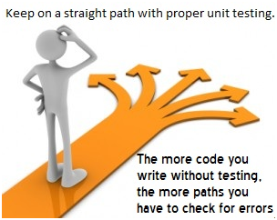
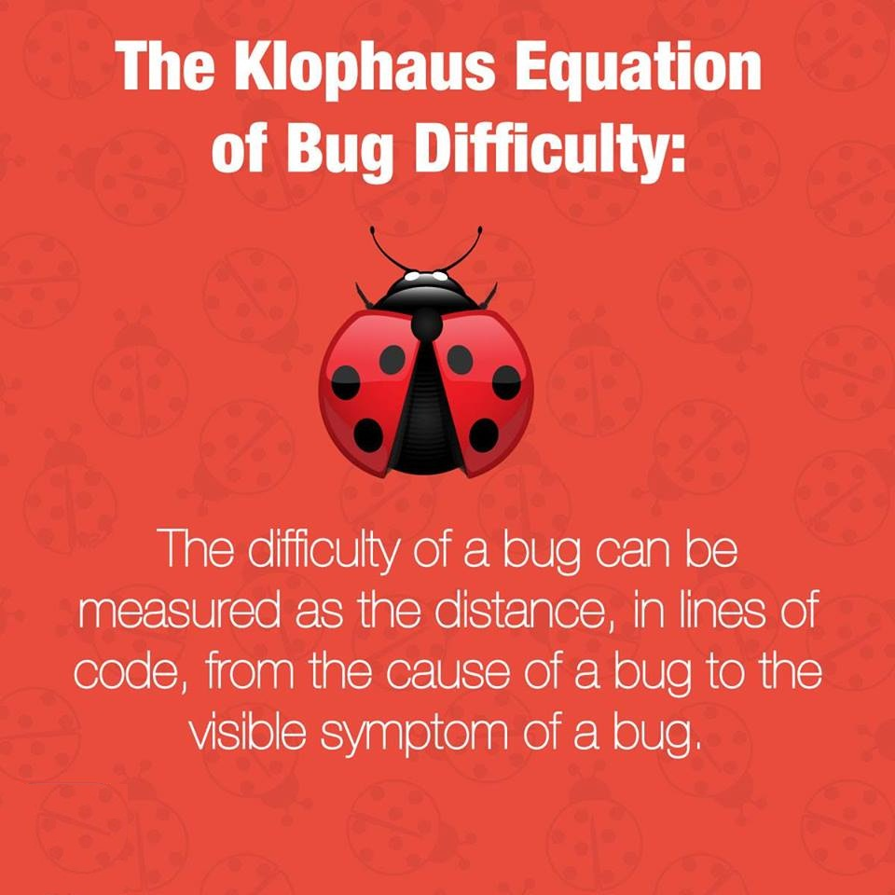
Notes:
Once your have the right code, then you can refactor and improve/optimize it to run faster! Or clean it up to be more readable and maintainable! My philosophy is always “Make it work, then make it pretty!”

